Slide 1
Lessons from the Transformation of the Labour Force Survey
Orlaith Fraser
Head of Statistical Transformation,
Social Surveys,
Office for National Statistics
orlaith.fraser@ons.gov.uk

Slide 2
Context
Steady downward trend in response rates
Unprecedented challenges to field data collection
Security - Ring doorbells, gated communities
Confidentiality – data sharing concerns
Post pandemic – not wanting strangers in your house
Anti-government feeling
Survey fatigue
Respondent doorstop refusal rates have doubled compared to pre-pandemic

Slide 3
Transforming Social Surveys
More representative data
More efficient operation
Reduced bias
Online-first design to target resources where needed most and drive up quality
Inclusive design
Effective, targeted use of resources
Better value for money
Higher quality data
Transformation of the Labour Force Survey

Slide 4
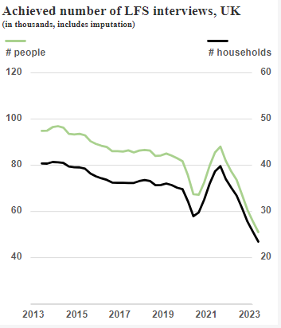
Labour Force Survey Transformation
The largest survey of private households in Great Britain
Official measurement of unemployment and employment
Longitudinal survey – households are invited to take part every 3 months for 5 waves
New survey designed to better withstand field collection challenges
Online-first approach enables people to respond at their convenience
Larger sample more robust to lower response rates
More flexible, responsive and operationally efficient
Driving up quality by targeting under-represented communities and transforming the questionnaire
Notes:
Why we need to transform

Slide 5
Focus for improved quality
1. Reducing Bias
Achieve representative sample
2. Reducing Attrition
Reduce drop-off in response between waves
Reduce impact of attrition on bias (especially by wave 5)
3. Improving Response
Sufficient response in each area to meet quality targets
Focus on both national and local improvements
Regions
Operational complexity
Increased response should reduce:​
Drive to maximise inclusivity
Minimise variability in response across
Output Area Classification
Ensure sufficient sample size in wave 5
Increased response must not introduce new bias
Respondent burden
Overall cost
Index of Multiple of Deprivation

Slide 6

Major TLFS Milestones
2017
2018
2019
2020
2022
2023
Tests 1 & 2
Online response rates
Engagement strategies
Test 3
Mixed mode (online & F2F) Statistical outcomes
Test 4
Online attrition test – response rates across 3 waves
TLFS Beta Launched
Online only in response to pandemic
Mixed Mode
Online & telephone collection
Adaptive Survey Design
Visits to specific households to encourage response

Slide 7
Engagement Strategy

Slide 8

Letters
Up to 3 letters sent to each household
Pre-Notification Letter (1 week before)
Invitation Letter (Day 1)
Reminder Letter (Day 12)
Extensive user testing on the content of these letters has taken place
Colour / branding of envelope
Timing of arrival
Tone of the content
Information respondents do / do not require

Slide 9

Incentives
All households receive a Notepad at Wave 1 as an unconditional incentive
This is included with their ‘Invite’ letter (which also contains their Unique Access Code for the online survey)
A £10 email voucher is also offered as a conditional incentive – a paper voucher can be provided on request
All people in a household need to complete to be eligible for the voucher

Slide 10


TLFS Wave 1 Timeline
Week 0
Pre-notification letter (1)
Week 1
Invitation letter (2)
Online data collection starts
Respondents can request a telephone interview
Week 2
Reminder letter (3)
Online data collection
Telephone interview by request
Week 3
‘Soft’ online completion deadline (Tuesday)
Knock-to-nudge visits start
Respondents can still complete online
2nd reminder may be sent if response is low
Week 4
‘Hard’ completion deadline (Sunday)
Knock-to-nudge visits continue
Respondents can still complete online

Slide 11
Respondent Centred Design

Slide 12

Questionnaire redevelopment
Understanding and meeting the user need, not just a definition
Understanding the respondent experience, ensuring collection is both respondent-centred and inclusive
Using data to design and taking an ‘optimode’ approach
Undertaking extensive systems-, flow- and cognitive-testing
Maintaining consistency with standards and time-series where possible

Slide 13
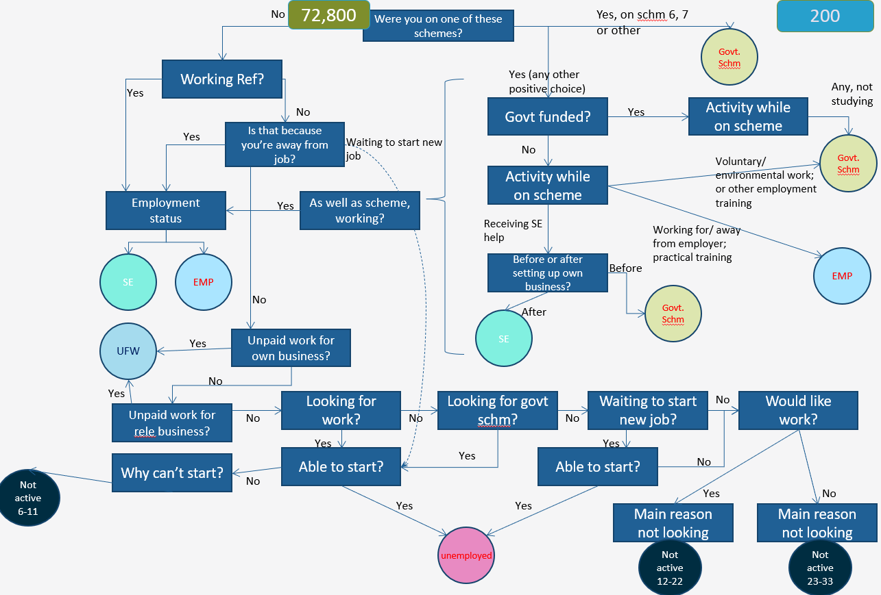
The start of the survey changed from this…
Complex
Only 2.7% of respondents answer ‘yes’ to the first question
Flow of questions is poor

Slide 14
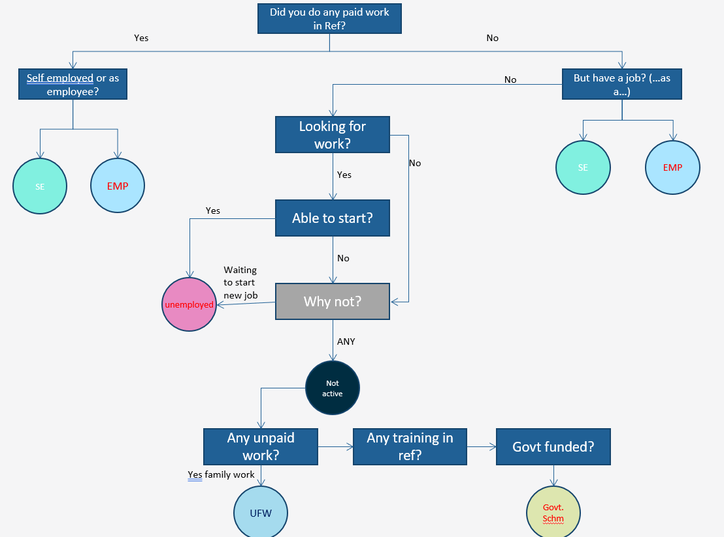
To this:
Simpler
More relatable – first question applies to everyone
Order of questions is more logical

Slide 15
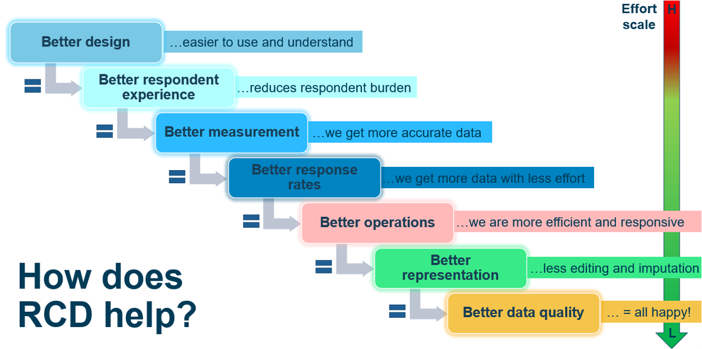
Notes:
LW – so, hopefully you can see that good design....read slide

Slide 16
Adaptive Survey Design

Slide 17
Enabling an adaptive & responsive design
Draw the sample
Invite people to take part
Follow-up non-responders
Process the data
At each stage making the best use of available data sources to target resources effectively
Designing to optimise response, improve inclusivity and drive up data quality
Notes:
Darren

Slide 18
Adaptive Survey Design on the TLFS
Targeted knock-to-nudge visits to encourage response from households in under-represented areas
Methodology
Used logistic regression, Coefficients of Variation (CVs) and Representivity Indicators (R Indicators) to identify the variables and categories of variables driving variation in response propensities
Strongest predictors of response
Age (<45)
Urban/Rural Classification (Urban)
Index of Multiple Deprivation (IMD deciles 1-4)
Constructed 8 strata based on these variables that were attached to the sampling frame

Slide 19
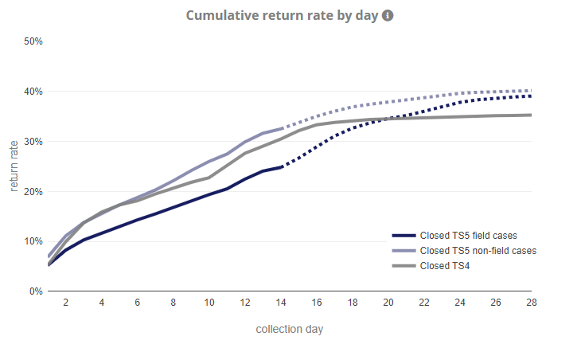
Impact of Knock-to-Nudge on Response
Cases that won’t receive knock-to-nudge visits (less deprived areas)
Knock-to-nudge starts (day 14)
Cases selected to receive Knock-to-Nudge visits if they don’t respond (areas with more deprivation, urban, younger people)
Cases selected for Knock-to-nudge
Cohorts before Knock-to-nudge was introduced
Cases not receiving knock-to-nudge
Response before knock-to-nudge was introduced

Slide 20
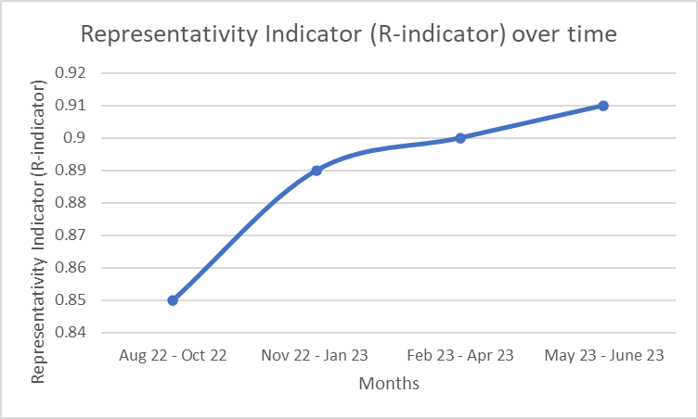
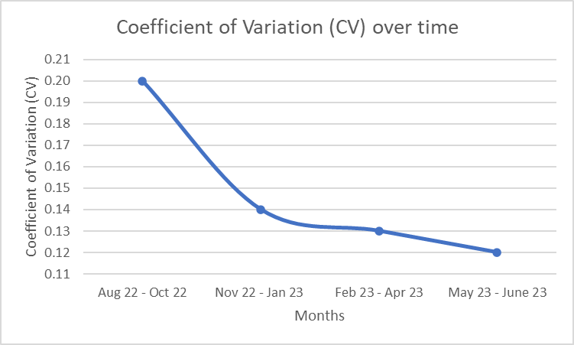
Evidence of reduction in bias
R indicators measure the extent to which a survey is representative of a population.
To see an improvement in the representativity of the data:
Increase in R indicator
CV in response propensities for a selected set of auxiliary variables.
To see an improvement in the representativity of the data:
Decrease in CV

Slide 21
Challenges & Next Steps

Slide 22


Challenges
Partial Responses
Individuals dropping out before completing the survey
Households without complete responses from every individual
Industry & Occupation
Challenging to collect detailed information without interviewer prompts
Household structure
Individual questions

Slide 23
Next steps
Testing the impact of shortening the questionnaire
Live Oct 24 – survey reduced by half to approx. 15 mins per household
Impact of different question blocks on drop out rates and characteristics of partially responding households
Further design development to enable a shorter ‘core’ questionnaire alongside wider data requirements pending test outcomes

Slide 24
Questions & Discussion

