Slide 1

Assessing the impact of video interviewing on measurement quality: Evidence from an experimental study on mode effects Marc Asensio*, Matt Brown*, Richard Silverwood*, Tim Hanson** and Gabriele Durrant*** *Centre for Longitudinal Studies, UCL; **City, University of London; ***University of Southampton

Slide 2

Acknowledgments
The data used in the present study is from the Centre for Longitudinal Studies’ “Measurement Lab”, funded by the UKRI Economic and Social Research Council.
This study has been conducted as part of the Survey Futures programme.

Slide 3

Context
Suspension of F2F interviewing during the COVID pandemic led to significant increase in the use of VI

Slide 4

Context
Suspension of F2F interviewing during the COVID pandemic led to significant increase in the use of VI
VI was adopted in studies like the ESS, the NCDS and the BCS70.

Slide 5

Context
Suspension of F2F interviewing during the COVID pandemic led to significant increase in the use of VI
VI was adopted in studies like the ESS, the NCDS and the BCS70.
Due to its rapid introduction, there is limited evidence about the impact of video interviewing on data quality – especially on measurement

Slide 6


Previous research
Non-experimental evidence suggests minor or no differences between in-person and video interviews (Hanson et al. 2025; Kelley et al. 2022; Zavala-Rojas et al. 2023).
=

Slide 7

Previous research
Non-experimental evidence suggests minor or no differences between in-person and video interviews (Hanson et al. 2025; Kelley et al. 2022; Zavala-Rojas et al. 2023).
Experimental evidence comparing the modes has also found a high degree of similarity between the two interview-administered modes (Endres et al. 2023; Sun et al. 2021).

Slide 8

Our contribution
Despite consistent evidence, existing research has been limited either by its non-experimental nature or by being conducted in lab-controlled settings.
Cannot disentangle self-selection effects
Lack of external validity
No Web-F2F-Video comparison

Slide 9
Our contribution
Despite consistent evidence, existing research has been limited either by its non-experimental nature or by being conducted in lab-controlled settings.
Cannot disentangle self-selection effects
Lack of external validity
No Web-F2F-Video comparison
We contribute to the current research by conducting a large-scale real world setting study experimentally comparing web and in-person interviews to video interviews.

Slide 10

Our research question
Is data collected by video-interview more comparable with data collected in-person or by web?

Slide 11
The data
Data comes from the “Measurement Lab” mode experiment
The aim of the experiment was to explore the impact of mode on some of the key measures included in the most recent sweeps of the Next Steps Age 32 Survey and the Millennium Cohort Study.
Newly recruited, independent sample.

Slide 12

The data
1,692 participants aged 20-40 in England
Soft quotas on age, gender and region to ensure a broadly representative sample

Slide 13
The data
1,692 participants aged 20-40 in England
Soft quotas on age, gender and region to ensure a broadly representative sample
Mode allocation using a rotation plan
Order of allocation randomised between sample points

Slide 14
The data
1,692 participants aged 20-40 in England
Soft quotas on age, gender and region to ensure a broadly representative sample
Mode allocation using a rotation plan
Order of allocation randomised between sample points
Web
F2F
Video

Slide 15




Questionnaire
Content: Items on household relationship, housing, activities and employment, finances, health and identity

Slide 16




Questionnaire
Content: Items on household relationship, housing, activities and employment, finances, health and identity
A self-completion module including items on financial literacy, life satisfaction, mental wellbeing, drinking and smoking behaviour and childhood circumstances.

Slide 17
Questionnaire
Content: Items on household relationship, housing, activities and employment, finances, health and identity
A self-completion module including items on financial literacy, life satisfaction, mental wellbeing, drinking and smoking behaviour and childhood circumstances.
Cognitive assessment test

Slide 18

The methodology
We compare the three modes on two indicators:
Item non-response
Differences in response distribution

Slide 19
The methodology
We compare the three modes on two indicators:
Item non-response
Differences in response distribution
Regression based approach using mode as main independent variable and controlling for a series of sociodemographic characteristics:
Age, sex and ethnicity
Education level, employment status and social grade
Region and household characteristics

Slide 20
The methodology
How non-response was handled?
Web: Skip button available.
In-person: Spontaneous non-response recorded but not proposed.
Video: Mix. Respondents could see the web interface. Interviewer read aloud the answer categories.

Slide 21
The methodology
How non-response was handled?
Web: Skip button available.
In-person: Spontaneous non-response recorded but not proposed.
Video: Mix. Respondents could see the web interface. Interviewer read aloud the answer categories.
How the self-completion module worked?
Web: As another module.
In-person: Tablet handed to the respondent. Interviewer present.
Video: Link provided to the respondent. Interviewer stayed on the call, camera on.

Slide 22
Item non-response
For each variable, we created a binary variable determining if the respondent provided or not an answer
We present separately the results for the self-completion module.
In general, item non-response was really low. Therefore, many variables were full observed or had to few missing as for being modelled.

Slide 23
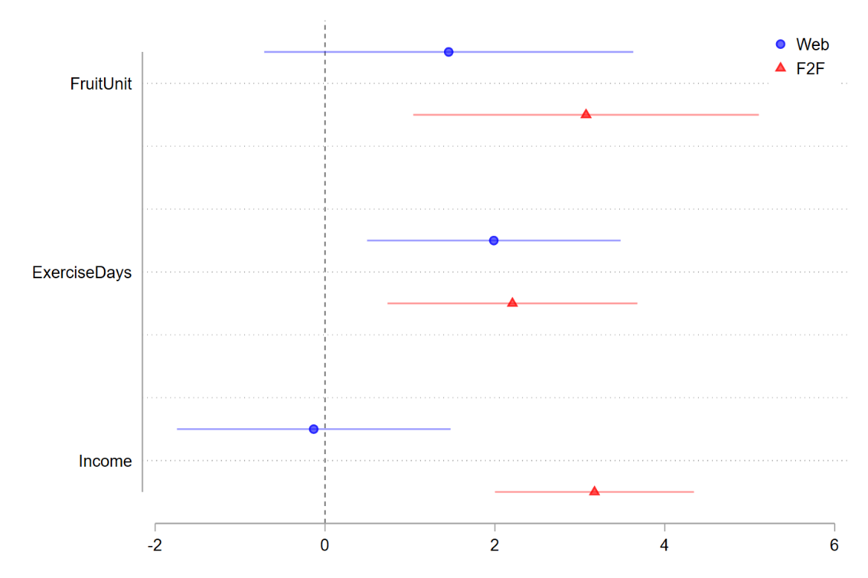
Item non-response
For the first part of the questionnaire, non-response was rare
Note: Logistic regression coefficients with 95% confidence intervals modelling unit non-response

Slide 24
Item non-response
For the first part of the questionnaire, non-response was rare
Non-response was more common in in-person (F2F), however.
Note: Logistic regression coefficients with 95% confidence intervals modelling unit non-response

Slide 25
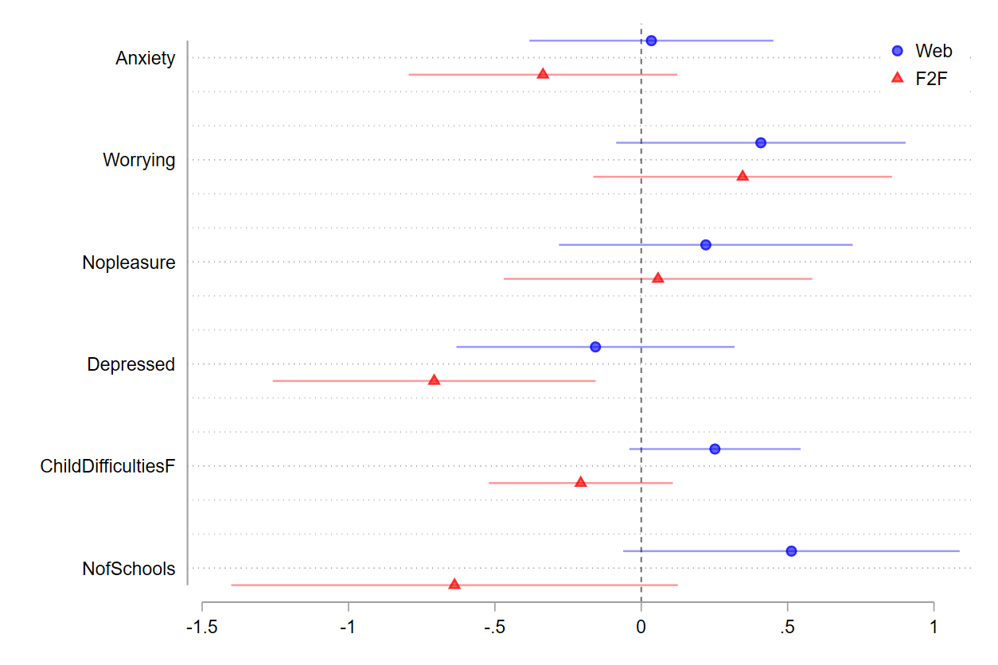
Item non-response
The self-completion module had a higher NR incidence
Despite this, no differences between modes were observed…
Note: Logistic regression coefficients with 95% confidence intervals modelling unit non-response

Slide 26
Item non-response
The self-completion module had a higher NR incidence
Despite this, no differences between modes were observed…
But for one item
Note: Logistic regression coefficients with 95% confidence intervals modelling unit non-response

Slide 27
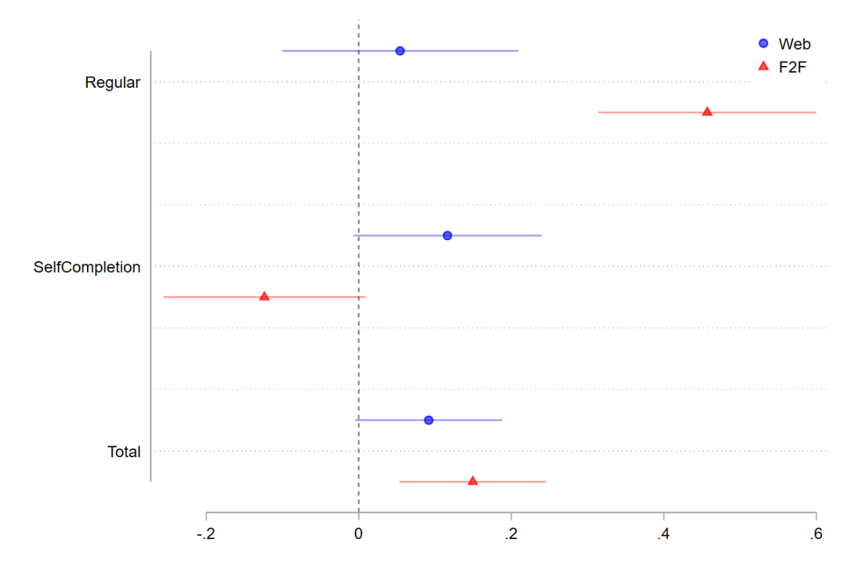
Item non-response: total
Despite observing differences between VI and F2F…
Note: Poisson regression coefficients with 95% confidence intervals modelling total non-response

Slide 28
Item non-response: total
Despite observing differences between VI and F2F…
These are practically negligible:
1.74 on average for F2F
1.40 for VI
1.61 for web
Note: Poisson regression coefficients with 95% confidence intervals modelling total non-response

Slide 29
Response distribution
We compared the response distribution of each variable
We regress each variable as a function of mode and controlling for a series of sociodemographic variables
Some variables required binary transformations
As before, we present the self-completion module results separately

Slide 30
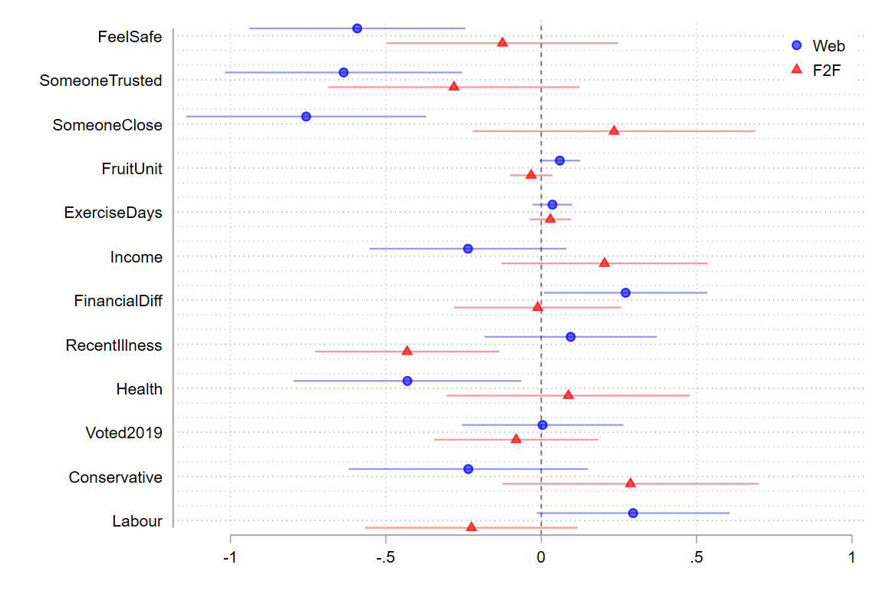
Response distribution
More differences between Web and VI
Note: Regression coefficients with 95% confidence intervals

Slide 31
Response distribution
More differences between Web and VI
In particular, items that could also be labelled as sensitive
Note: Regression coefficients with 95% confidence intervals

Slide 32
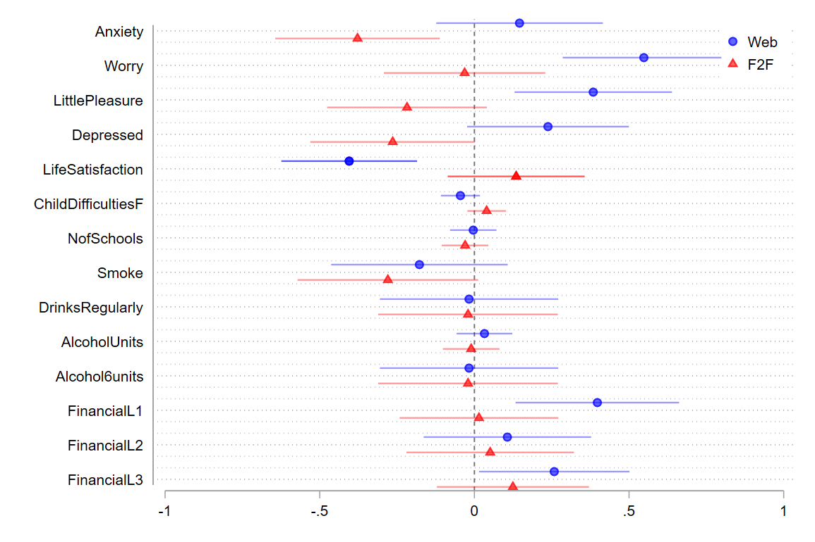
Response distribution
Similarly, we again observed more differences for the Web-VI comparison
Note: Regression coefficients with 95% confidence intervals

Slide 33
Response distribution
Similarly, we again observed more differences for the Web-VI comparison
Especially in items related to mental wellbeing
Note: Regression coefficients with 95% confidence intervals

Slide 34
Response distribution
Similarly, we again observed more differences for the Web-VI comparison
Especially in items related to mental wellbeing
As well as for the financial literacy test
Note: Regression coefficients with 95% confidence intervals

Slide 35
Conclusions
Video interviews showed lower item non-response than in-person (but almost negligible!)

Slide 36
Conclusions
Video interviews showed lower item non-response than in-person (but almost negligible!)
Few differences between interviewer-administered modes, but significant mode effects between web and VI, especially on sensitive items

Slide 37
Conclusions
Video interviews showed lower item non-response than in-person (but almost negligible!)
Few differences between interviewer-administered modes, but significant mode effects between web and VI, especially on sensitive items
Evidence of social desirability bias in VI (even in the self-completion module!)

Slide 38
Conclusions
Video interviews showed lower item non-response than in-person (but almost negligible!)
Few differences between interviewer-administered modes, but significant mode effects between web and VI, especially on sensitive items
Evidence of social desirability bias in VI (even in the self-completion module!)
Web respondents performed better on the financial literacy test (external aid?)

Slide 39
Going forward
Video interviewing could complement or replace in-person interviews with minimal impact on measurement

Slide 40
Going forward
Video interviewing could complement or replace in-person interviews with minimal impact on measurement
Self-completion modules are not fully effective. Consider different video-specific design adaptations (e.g., turning camera off)

Slide 41
Going forward
Video interviewing could complement or replace in-person interviews with minimal impact on measurement
Self-completion modules are not fully effective. Consider different video-specific design adaptations (e.g., turning camera off)
But the interviewer presence is of benefit for other aspects

Slide 42
Going forward
Video interviewing could complement or replace in-person interviews with minimal impact on measurement
Self-completion modules are not fully effective. Consider different video-specific design adaptations (e.g., turning camera off)
But the interviewer presence is of benefit for other aspects
Future research should test, on a broader range of measures, other designs and populations, especially where uptake is variable

Slide 43
Thank you for your attention! Questions?
Check the Survey Futures website for our WP
You can reach me at marc.asensiomanjon@unil.ch

