Slide 1
Video Interviewing Workshop

Slide 2
Research Strand 3 – Video interviewing
Background:
Use of video-interviewing to conduct social surveys is relatively new
Use of the mode accelerated significantly during the pandemic
Key questions:
What are the merits of this new mode and does it have a post-pandemic future?
How should video interviewing be optimally conducted to maximise quality?
Notes:
A quick reminder of the main team –the research strand is lead by me, Tim Hanson and Gabi Durrant
Sebastian Kocar initially appointed as Research Fellow but unfortunately decided to move back to Australia and so left UCL in the summer. Marc Asencio – who has recently completed a Phd in Survey Methods at Lausanne will now take up the post next month.
Other core collaborators.

Slide 3
Team
Research Strand leads: Matt Brown (UCL), Tim Hanson (City), and Gabriele Durrant (University of Southampton)
Researchers:
Sebastian Kocar, UCL - now based at University of Queensland
Marc Asensio, UCL - now based at University of Lausanne
Helena Koerber, UCL - Centre for Longitudinal Studies
Core collaborators: Carole Sanchez (UCL), Carina Cornesse (GESIS, Germany), Martin Wood (NatCen), Sam Spencer (NatCen)
Notes:
A quick reminder of the main team –the research strand is lead by me, Tim Hanson and Gabi Durrant
Researchers
core collaborators.

Slide 4
Programme
Introduction
Matt Brown and Gabriele Durrant
Evidence from the UK
Matt Brown: Measurement Mode Effects in Live Video Interviewing: Evidence from the 1970 British Cohort Study
Marc Asensio Manjon: Assessing the impact of video interviewing on measurement quality: Evidence from an experimental study on mode effects
Helena Koerber: Video Interviewing in the European Social Survey: A Post-Pandemic View
International Evidence
Andrew Hupp: Effort and Costs of Conducting Video Interviews in a Large-Scale, Mixed-Mode Design
Julia Witton: Video-Interviews in Mixed-Mode Panel Surveys: Selective Feasibility and Data Quality Trade-offs
Discussion
Tim Hanson: Future prospects of video interviewing
Notes:
We will put the programme into the chat
We will put all links into the chat

Slide 5
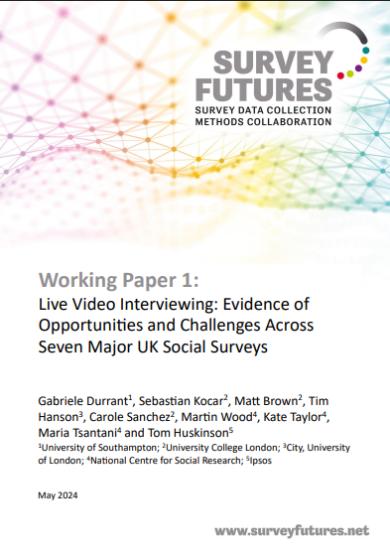
Use of VI in the UK
Evidence from across 7 major UK surveys:
uptake, response
characteristics of VI respondents
feasibility of collecting complex survey measures
Key findings:
Video-first led to lower response than F2F
Low-levels of take up when alternative modes offered
Suitable approach for collecting complex measurements
Potential to work as complementary mode in mixed-mode survey design, offering more cost-efficient fieldwork
In particular, in longitudinal surveys
Forthcoming in mda special issue on VI (2026)
https://surveyfutures.net/wp-content/uploads/2024/06/working-paper-01-live-video-interviewing.pdf
Notes:
feasibility of collecting complex survey tasks (consent, cognitive assessment, sensitive questions)
Also encouraging findings:
This is a key finding since previous research has identified limitations of other remote methods for collecting this kind of data, which is an important component of many studies, especially longitudinal studies.
An increase in LVI uptake in both longitudinal and cross-sectional surveys may be expected over time as online working becomes increasingly common and some barriers to LVI can be addressed.

Slide 6
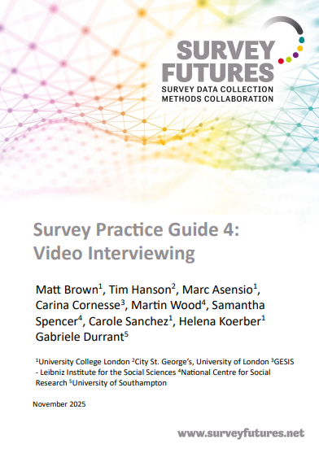
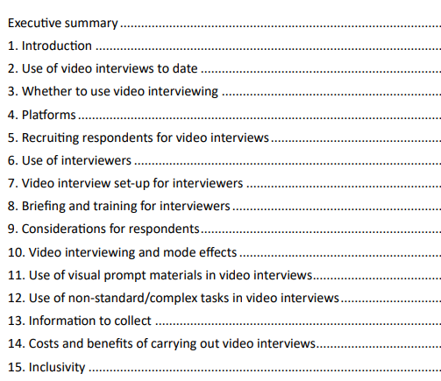
Survey Practice Guide
https://surveyfutures.net/wp-content/uploads/2025/11/survey-practice-guide-4-video-interviewing.pdf

